Slide 1
IPC ICHP & ASV
DRAFT

Slide 2
Agenda
Utiliser ICHP pour nos Assets TPA ASV
Modularisation de nos backends

Slide 3
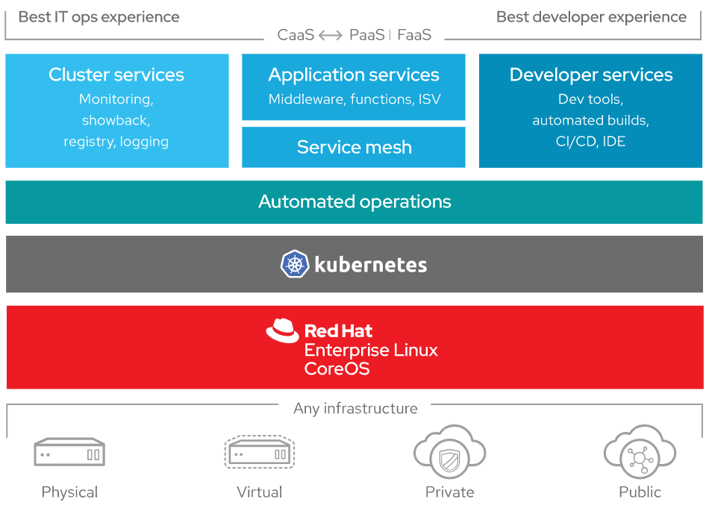
Cluster Openshift
Red Hat OpenShift is the industry's most secure and comprehensive enterprise-grade container platform based on industry standards, Docker and Kubernetes
#Deployment Zero interruption
#Monitoring
#Logging
#Supervision
#Easy rollback
#Secret management
#Network management

Slide 5
Openshift Objects
Project
Pod
Service
Route
Label
DeploymentConfig
Config Maps
Secret
Persistent Volume Claims
Network Policies
Service Accounts
Role Bindings
Roles
Resource Quotas
Limit Ranges
Replication Controllers

Slide 6







Cluster Openshift
Rubik Web App
Rubik Mobile App
DMZ
API Gateway
CDaaS
Cluster
API A
API A
API B
API B
namespace
avangers
namespace
ocomps
namespace
staging
Project : asv

Slide 7
Actions :
Vérifier les habilitations pour la création des projets en développement
Vérifier les habilitations pour la création des projets en production
Pipeline Cdaas
Flux local connexion
Intégration API Gateway, Phoenix
Monitoring des containers
Liens :
Création Project Openshift
Pipeline CDaaS

Slide 8

Modularisation Asv Backends
Rubik Mobile App
Rubik Web App
Rubik Mobile App
Rubik Web App
ASV WC
ASV WC
ASV WC
ASV WC
API Gateway
API Gateway
ING Global Service
ASV Experience API
ASV Experience API
TPA ASV
ASV Engine API
Generali
ASV subscribe API
ASV contract in life API
ASV subscribe API
ASV contract in life API
…
…
TPA
Generali API
Generali API

